Slide 1
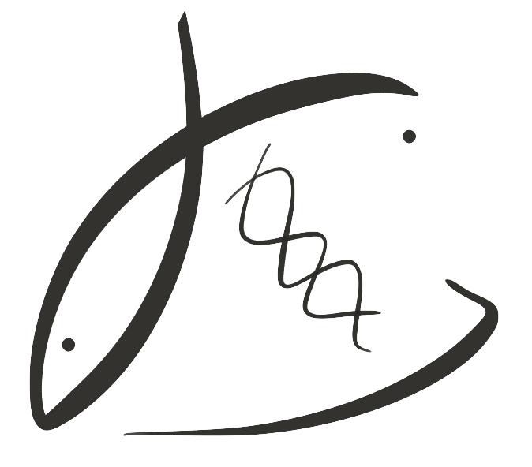





Parental low pH exposure affects reproduction & larval gene expression in the Olympia oyster
Laura H Spencer
Roberts Lab
School of Aquatic and Fishery Sciences
University of Washington
NSA Triennial, New Orleans 2019
Notes:
Change font Sans serif fonts for presentation
Change title to make it more like a paper title

Slide 2
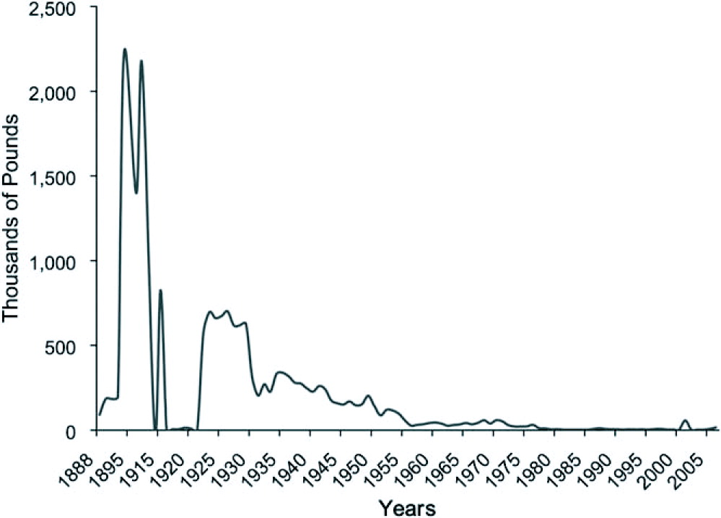
The Olympia oyster
Pacific Coast’s only native oyster, populations crashed early 1900’s
White, Ruesink & Trimble, 2009
Notes:
MAP: Augmented map of 2009 Olympia oyster survey that found some locations Olys are absent entirely or absent in the intertidal.
Don’t say pacific oyster …
Walk people through each figure
Put coastal images side by side,
- …
-

Slide 3
The Olympia oyster
Emerging threat: ocean acidification
Ocean acidification amplified along North American Pacific Coast
Shown: depth of corrosive water
(Ω-undersaturated)
Feely et al 2017

Slide 4
Ocean acidification, Olympia oyster
Negative impacts of larval exposure
⬇ Larval growth, survival (Hettinger et al. 2013)
⬇ Juvenile growth after larval exposure (Hettinger et al. 2012)
⬆ Juvenile predation rate (Sanford et al. 2013)
Also evidence of larval tolerance (Waldbusser 2016)
Notes:
Change font to make title way different
Make Waldbusser’s paper pose a question … another author shows tolerance, maybe
Parental exposure? On next slide (and/or talk more about waldbusser)

Slide 5
Parental carryover effects?
Notes:
Put question on the next slide … one slide with “Olympia oyster? Mechanisms?”
Parental exposure can influence offspring response to stress (e.g. Parker et al. 2012)
This may allow oyster populations to quickly respond to changing ocean
Parker 2012:
Parents exposed during reproductive conditioning
Larvae from exposed parents larger, grew faster
Larvae exposed to low pH did OK if parent was exposed. BUT, if exposed to a secondary stressor, not OK

Slide 6
“Memory” of OA passed on to offspring, other oysters
Negative carry-over:
⬇ larval survival (Venkataraman et al. 2019)
Positive carry-over:
⬆ larval growth (Parker et al. 2012, 2015, 2017)
Notes:
Put question on the next slide … one slide with “Olympia oyster? Mechanisms?”
Parental exposure can influence offspring response to stress (e.g. Parker et al. 2012)
This may allow oyster populations to quickly respond to changing ocean
Parker 2012:
Parents exposed during reproductive conditioning
Larvae from exposed parents larger, grew faster
Larvae exposed to low pH did OK if parent was exposed. BUT, if exposed to a secondary stressor, not OK

Slide 7
Olympia oyster? Mechanisms?
Notes:
Put question on the next slide … one slide with “Olympia oyster? Mechanisms?”
Parental exposure can influence offspring response to stress (e.g. Parker et al. 2012)
This may allow oyster populations to quickly respond to changing ocean
Parker 2012:
Parents exposed during reproductive conditioning
Larvae from exposed parents larger, grew faster
Larvae exposed to low pH did OK if parent was exposed. BUT, if exposed to a secondary stressor, not OK

Slide 8

Design
Time
Phase
pH
Adults in pH treatment
(7 weeks)
Low (7.3) Ambient (7.8)
Adults conditioned/ induced to spawn
(4 weeks)
Ambient
(7.8)
Larvae collected
(9 weeks)
Notes:
Change Colors …
Remove metrics
Include pretty pictures or icons
Emphasize when pH treatment occurred
Use simplified flow chart here and on each results slide

Slide 9
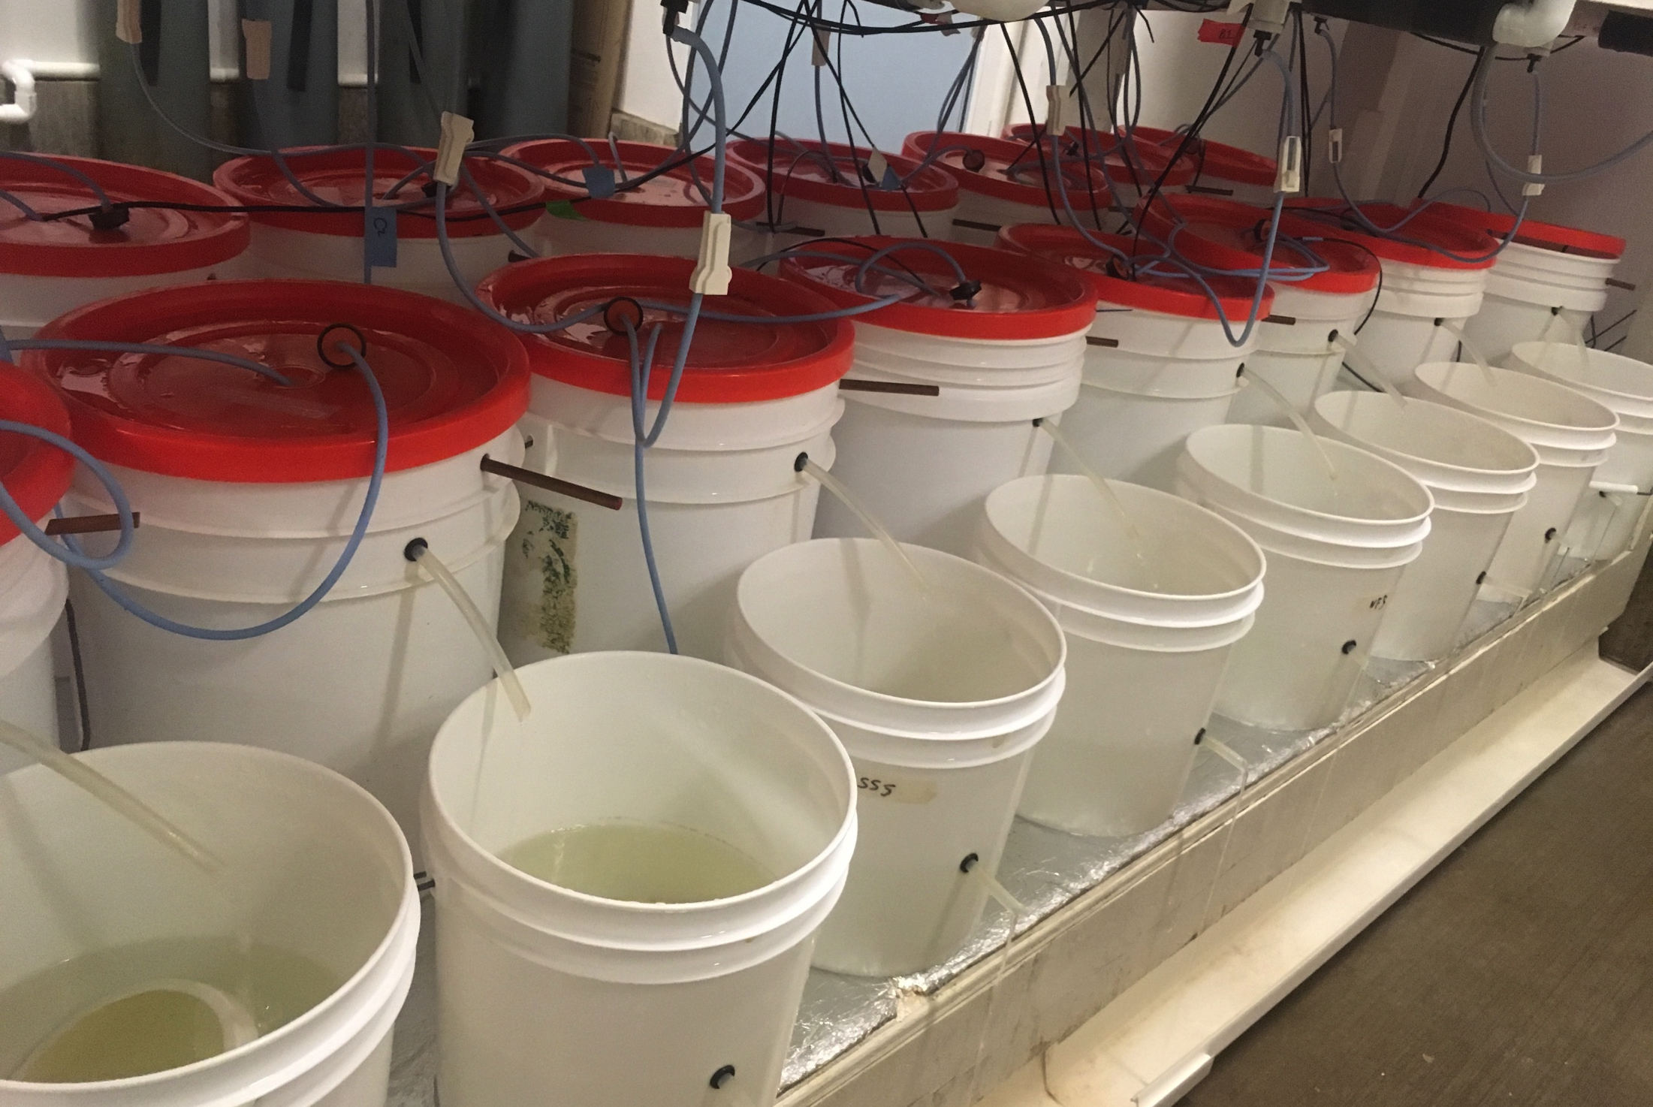
Larvae collected & counted for 9 weeks
Adults in pH treatment
Adults conditioned
Larvae collected

Slide 10
No pH effect on fecundity
n = 380 adults per pH treatment
No Difference
1M
500K
Adults in pH treatment
# larvae released
No Difference
Adults conditioned
Week
0 1 2 3 4 5 6 7 8 9
Larvae collected
1M
500K
# larvae released
Week
0 1 2 3 4 5 6 7 8 9
Notes:
Re-label axes, x and y – make it really big.
Spend more time talking about why this might matter
Tell how many oysters are here, that they were genetically diverse (767 oysters used total, ~375 per treatment)

Slide 11
No pH effect on fecundity Larval release delayed
n = 380 adults per pH treatment
June 1
No Difference
1M
500K
May 17
Adults in pH treatment
# larvae released
No Difference
Adults conditioned
Week
0 1 2 3 4 5 6 7 8 9
Larvae collected
May 22
June 12
1M
500K
# larvae released
Week
0 1 2 3 4 5 6 7 8 9

Slide 12
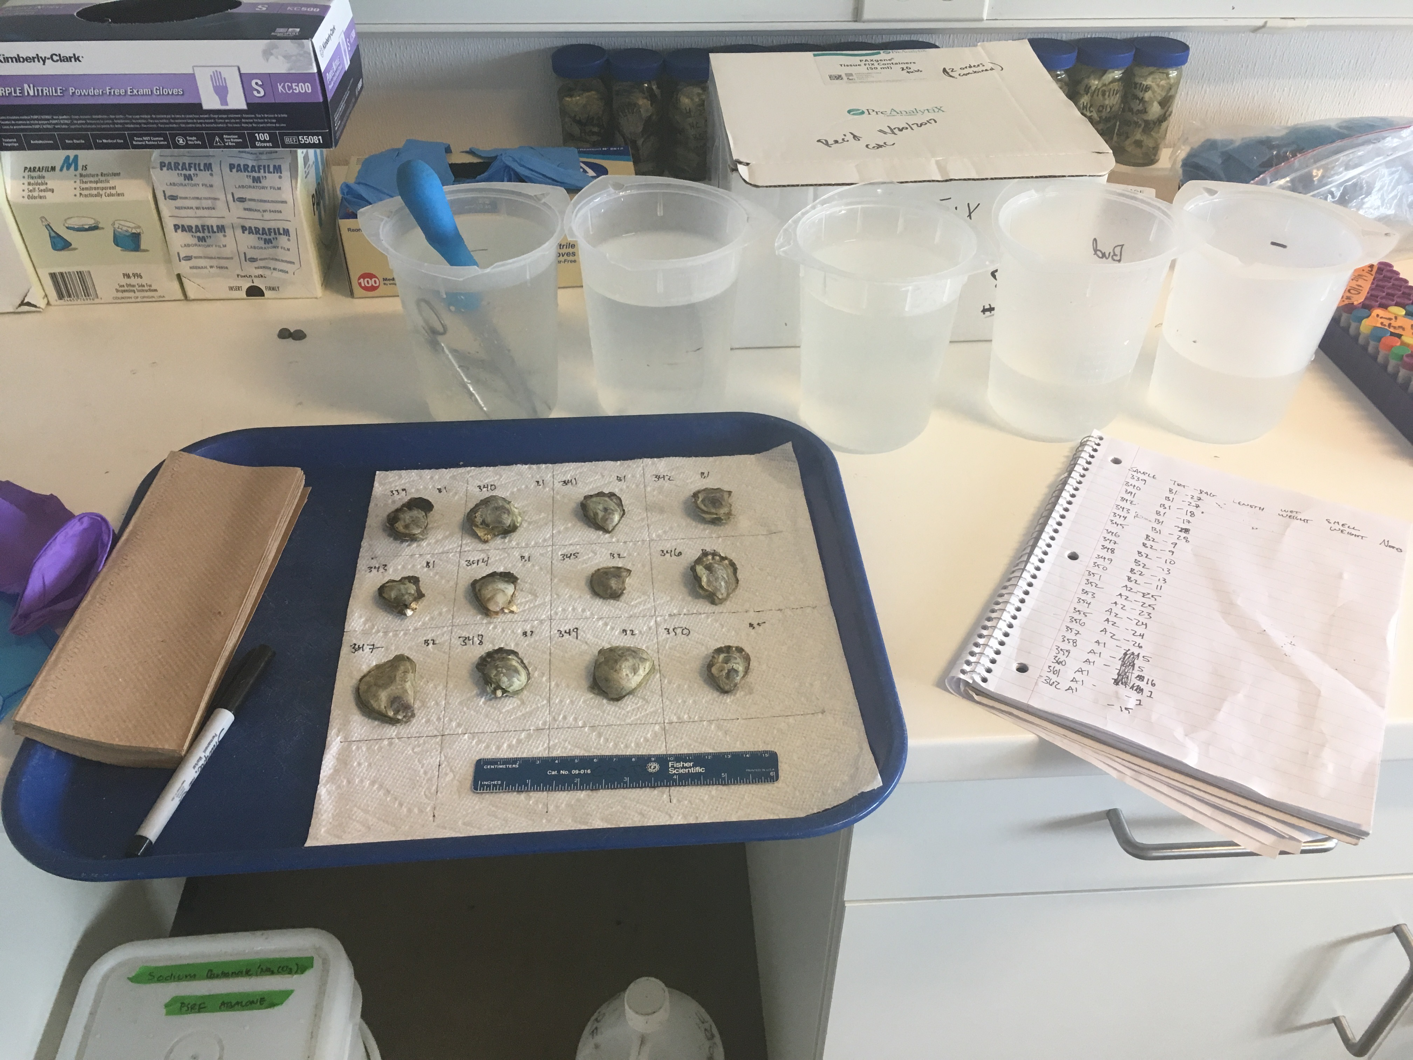
Adult gonad tissue sampled, RNA isolated & sequenced
Adults in pH treatment
Adults conditioned
Larvae collected
Notes:
Explain this
UP
Thymidylate synthase Nucleotide biosynthesis
H/ACA ribonucleoprotein complex subunit DKC1 Ribosome biogenesis, rRNA processing
Elongation factor 1-delta protein biosynthesis
C-terminal-binding protein Transcription regulation
HSP70 protein stabilization
DOWN:
Defense response:
Macrophage-expressed gene 1 protein host defense against bacteria
Hemagglutinin/amebocyte aggregation factor aggregation of amebocytes and agglutination of erythrocytes
Coactosin-like protein defense response to fungus
Biosynthesis / cell regulation:
Haloacid dehalogenase-like hydrolase domain-containing 5 glycerophospholipid biosynthetic process
Protein quaking-B cell differentiation, mRNA processing, regulation of translation, RNA splicing
Endoglucanase cellulose cellulose catabolic process
Rho guanine nucleotide exchange factor 3 intracellular signal transduction
S-crystallin SL11 S-crystallins are structural components of squids and octopi eye lens. Contains relatively little if any GST activity

Slide 13
Adult gonad Gene expression
RNA sequenced using QuantSeq
Processes affected by direct pH exposure:
Aerobic respiration
Defense response to bacteria, fungus
Protein transport & stabilization
Biosynthesis (DNA, protein)
Cellulose digestion
Intracellular signaling
Adults in pH treatment
PCA Biplot, normalized gene counts
Adults conditioned
Larvae collected
Notes:
Explain this
UP
Thymidylate synthase Nucleotide biosynthesis
H/ACA ribonucleoprotein complex subunit DKC1 Ribosome biogenesis, rRNA processing
Elongation factor 1-delta protein biosynthesis
C-terminal-binding protein Transcription regulation
HSP70 protein stabilization
DOWN:
Defense response:
Macrophage-expressed gene 1 protein host defense against bacteria
Hemagglutinin/amebocyte aggregation factor aggregation of amebocytes and agglutination of erythrocytes
Coactosin-like protein defense response to fungus
Biosynthesis / cell regulation:
Haloacid dehalogenase-like hydrolase domain-containing 5 glycerophospholipid biosynthetic process
Protein quaking-B cell differentiation, mRNA processing, regulation of translation, RNA splicing
Endoglucanase cellulose cellulose catabolic process
Rho guanine nucleotide exchange factor 3 intracellular signal transduction
S-crystallin SL11 S-crystallins are structural components of squids and octopi eye lens. Contains relatively little if any GST activity

Slide 14
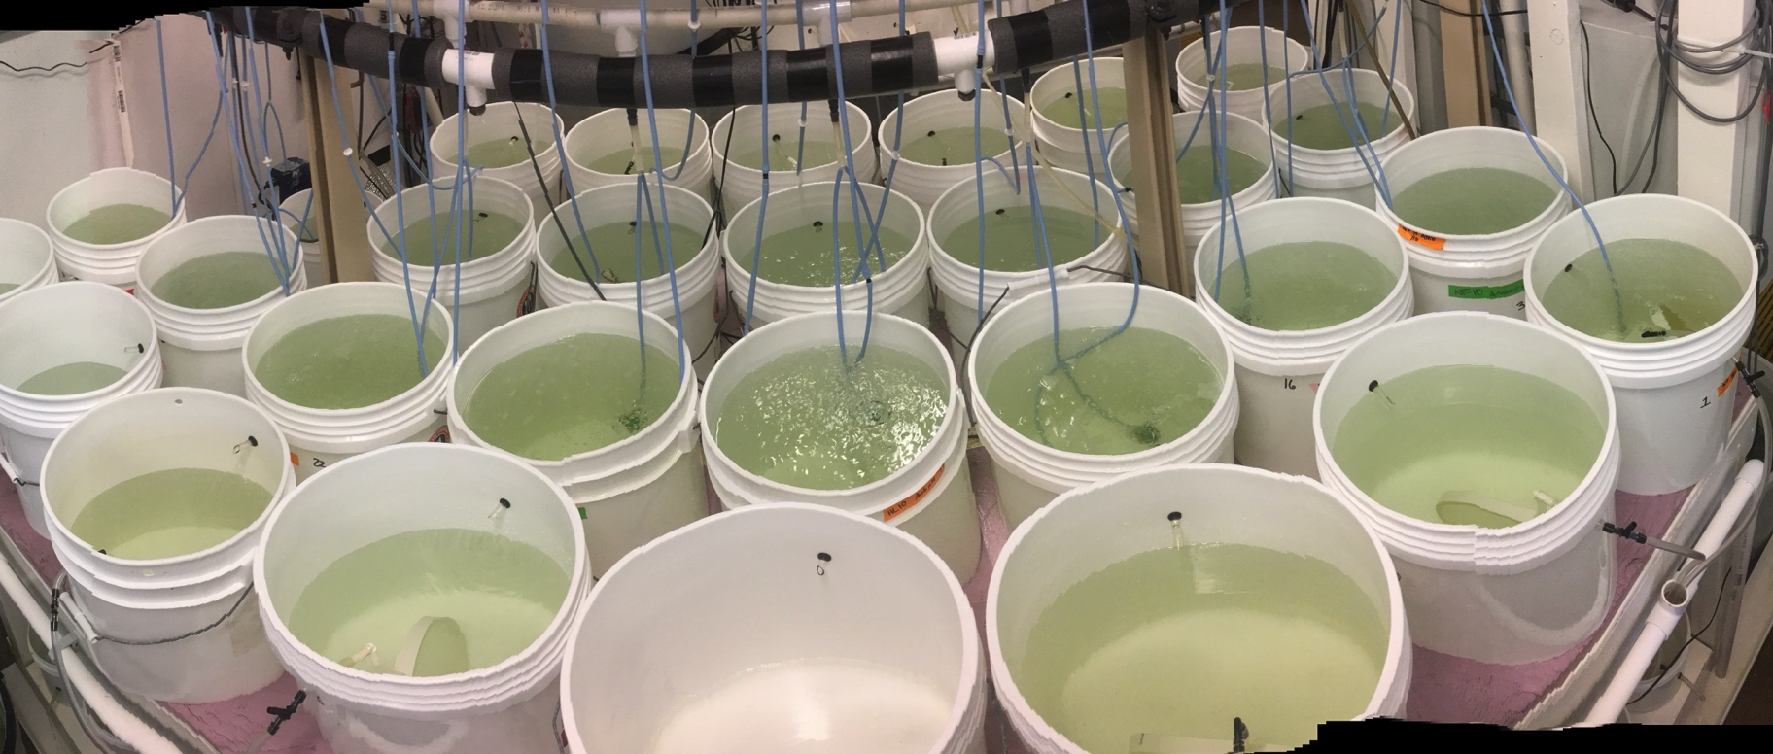
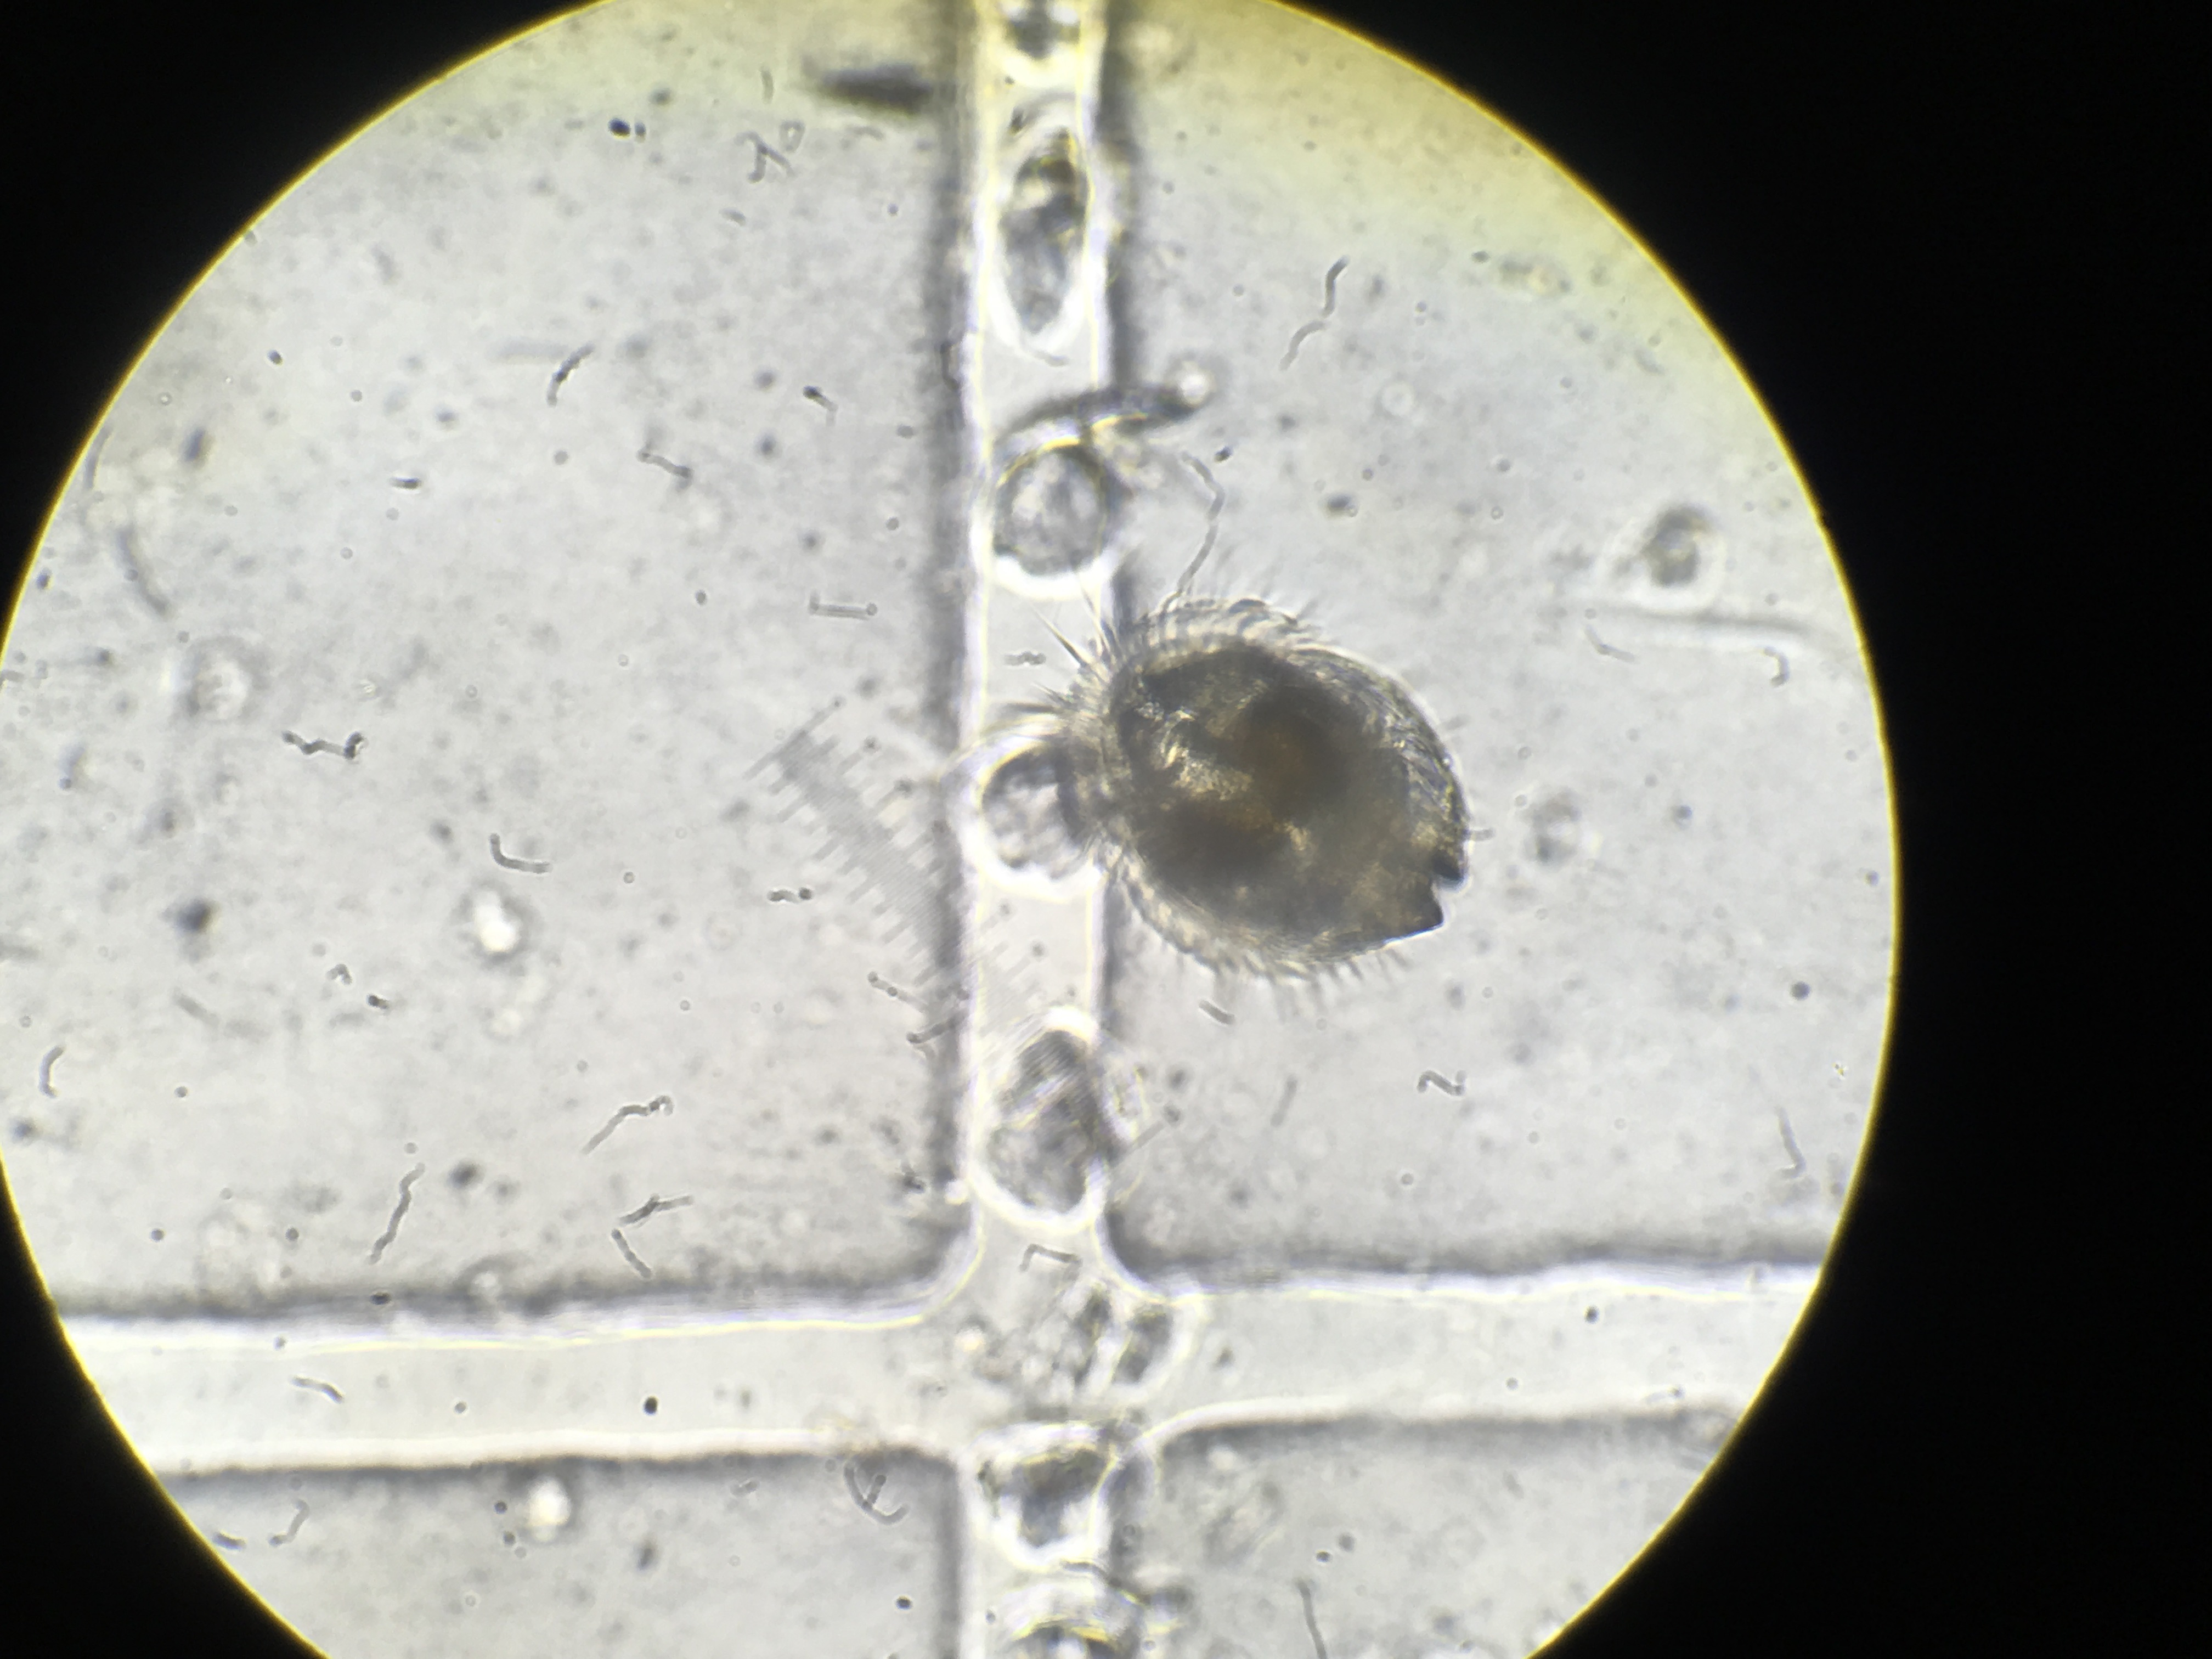
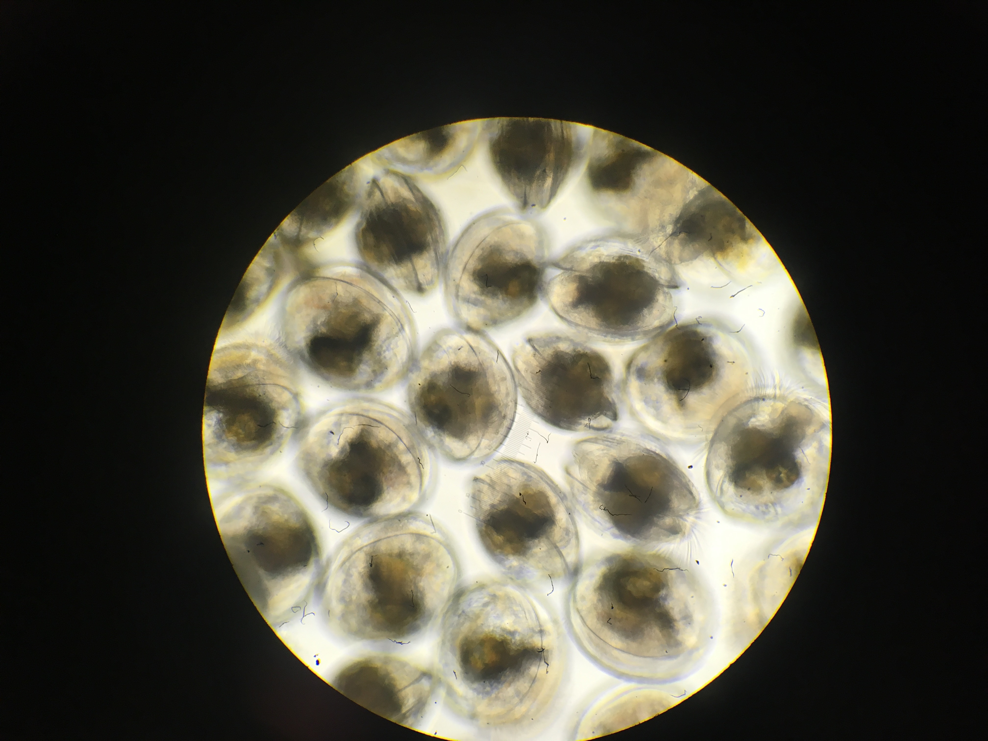
Larvae collected Subset sequenced, reared
Adults in pH treatment
Adults conditioned
Larvae collected

Slide 15
Newly released larvae
gene expression
Parental pH
Adults in pH treatment
RNA sequenced using QuantSeq
Processes affected by parental pH exposure
Aerobic respiration (COI, Mt:ND5)
DNA repair (USP47)
Protein transport (TBC1D2)
Cytoskeleton (Tuba3-⍺)
Cytoplasmic translation (rpl8)
PCA Biplot, normalized gene counts
Adults conditioned
rpl8
Tuba3-⍺
TBC1D2
Mt:ND5
Larvae collected
USP47
COI
COI: Cytochrome c oxidase, aerobic respiration
mt:ND5: NADH-ubiquinone oxidoreductase, mitochondrial electron transport
USP47: Ubiquitin component, DNA repair
TBC1D2: protein transport, GTPase activity
Tuba3a: Tubulin, cytoskeleton
Rpl8: ribosomal protein, cytoplasmic translation
Notes:
One larval pulse …

Slide 16
What does this mean?
Parental pH delays reproduction … later larval release in wild, may alter larval recruitment
Parental pH exposure alters larval physiology … Future generations more capable of surviving in low pH world?
Notes:
Later larval release adaptive response?
Negative or positive?
Remind them why this is important for restoration …
I don’t know if this is good or bad

Slide 17
Possible next steps
Explore offspring low pH response …
Different response to acute low pH shock if parent was exposed? (qPCR)
Why does expression differ?…
Epigenomes

Slide 18
thank you
Collaborators: Katherine Silliman, Yaamini Venkataraman, Steven Roberts
Puget Sound Restoration Fund: Ryan, Stuart, Alice, Erin, Jade, Morgan, Brian, Betsy …
On-the-ground: Yaamini, Grace, Olivia, Megan, Rhonda, Kaitlyn, Lindsay, Duncan, Sam, Hollie, Steven, Steven’s kids, Brent, Mom & Ian
Committee: Steven, Rick, Jackie

Slide 19
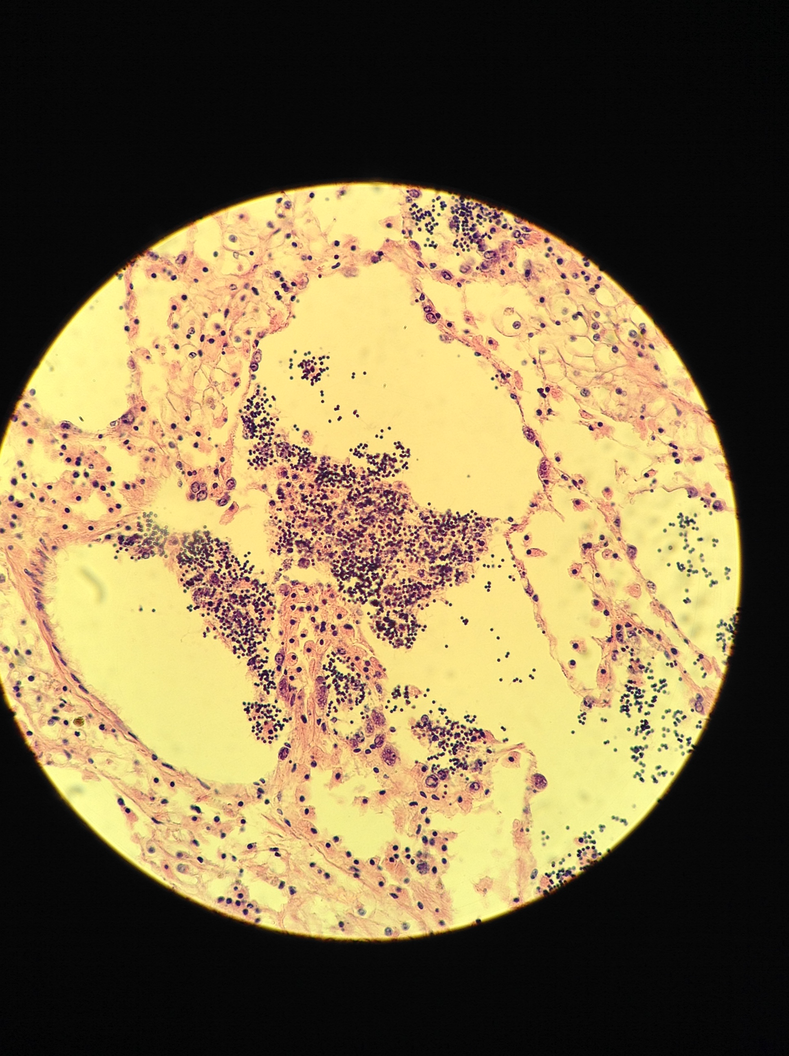
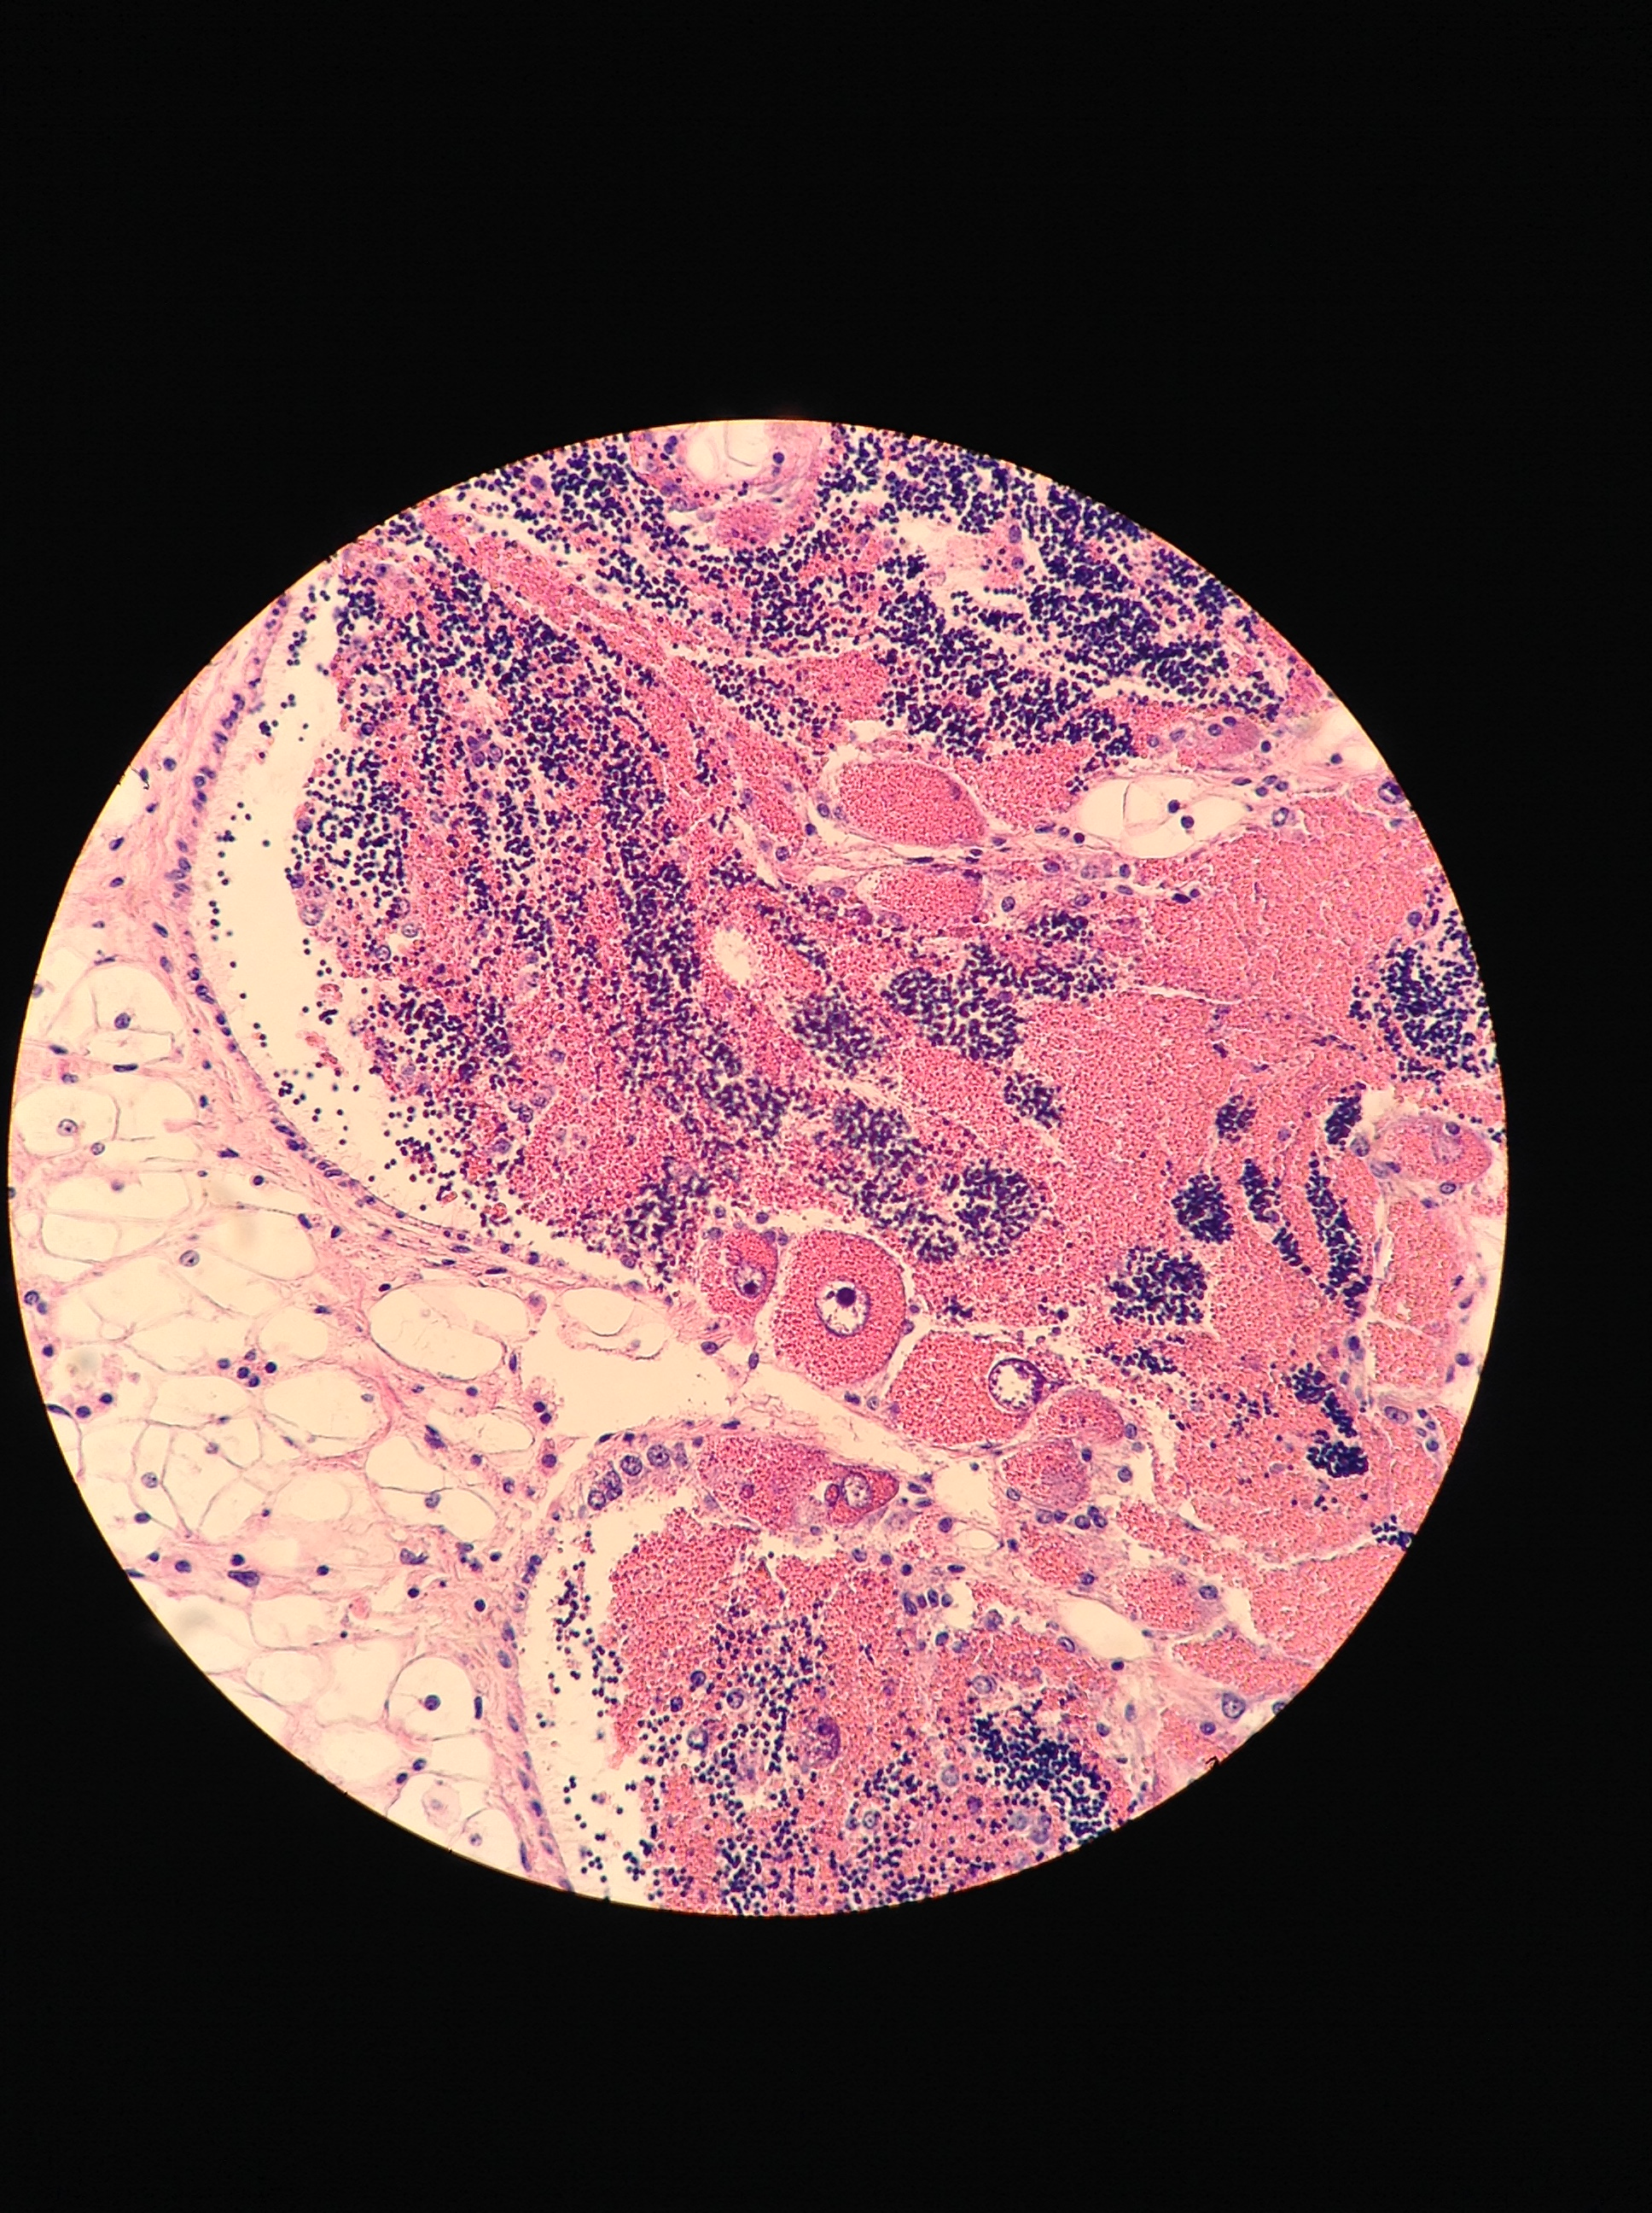
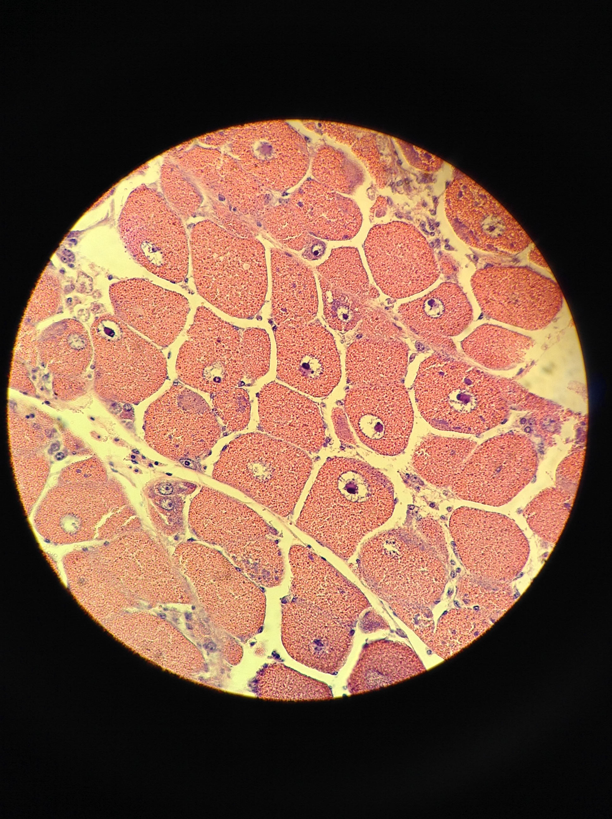
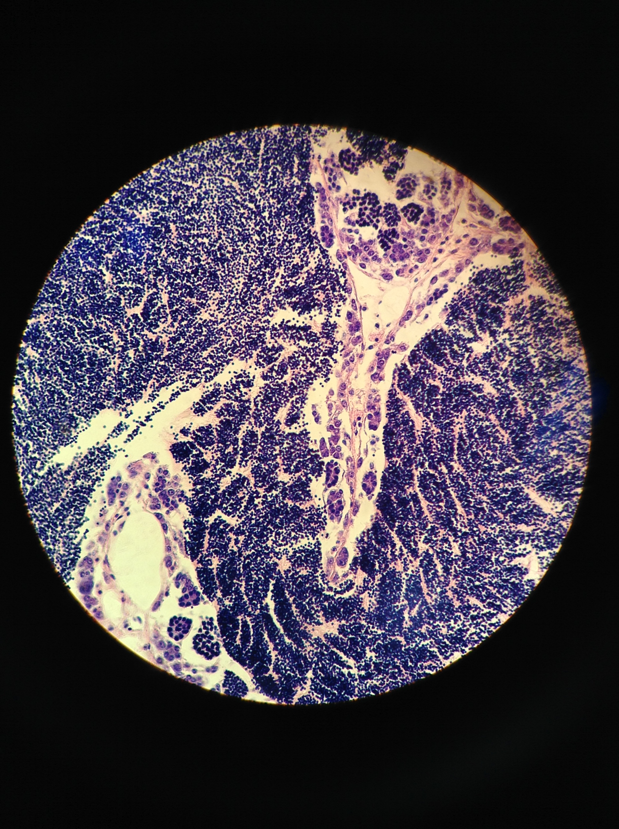
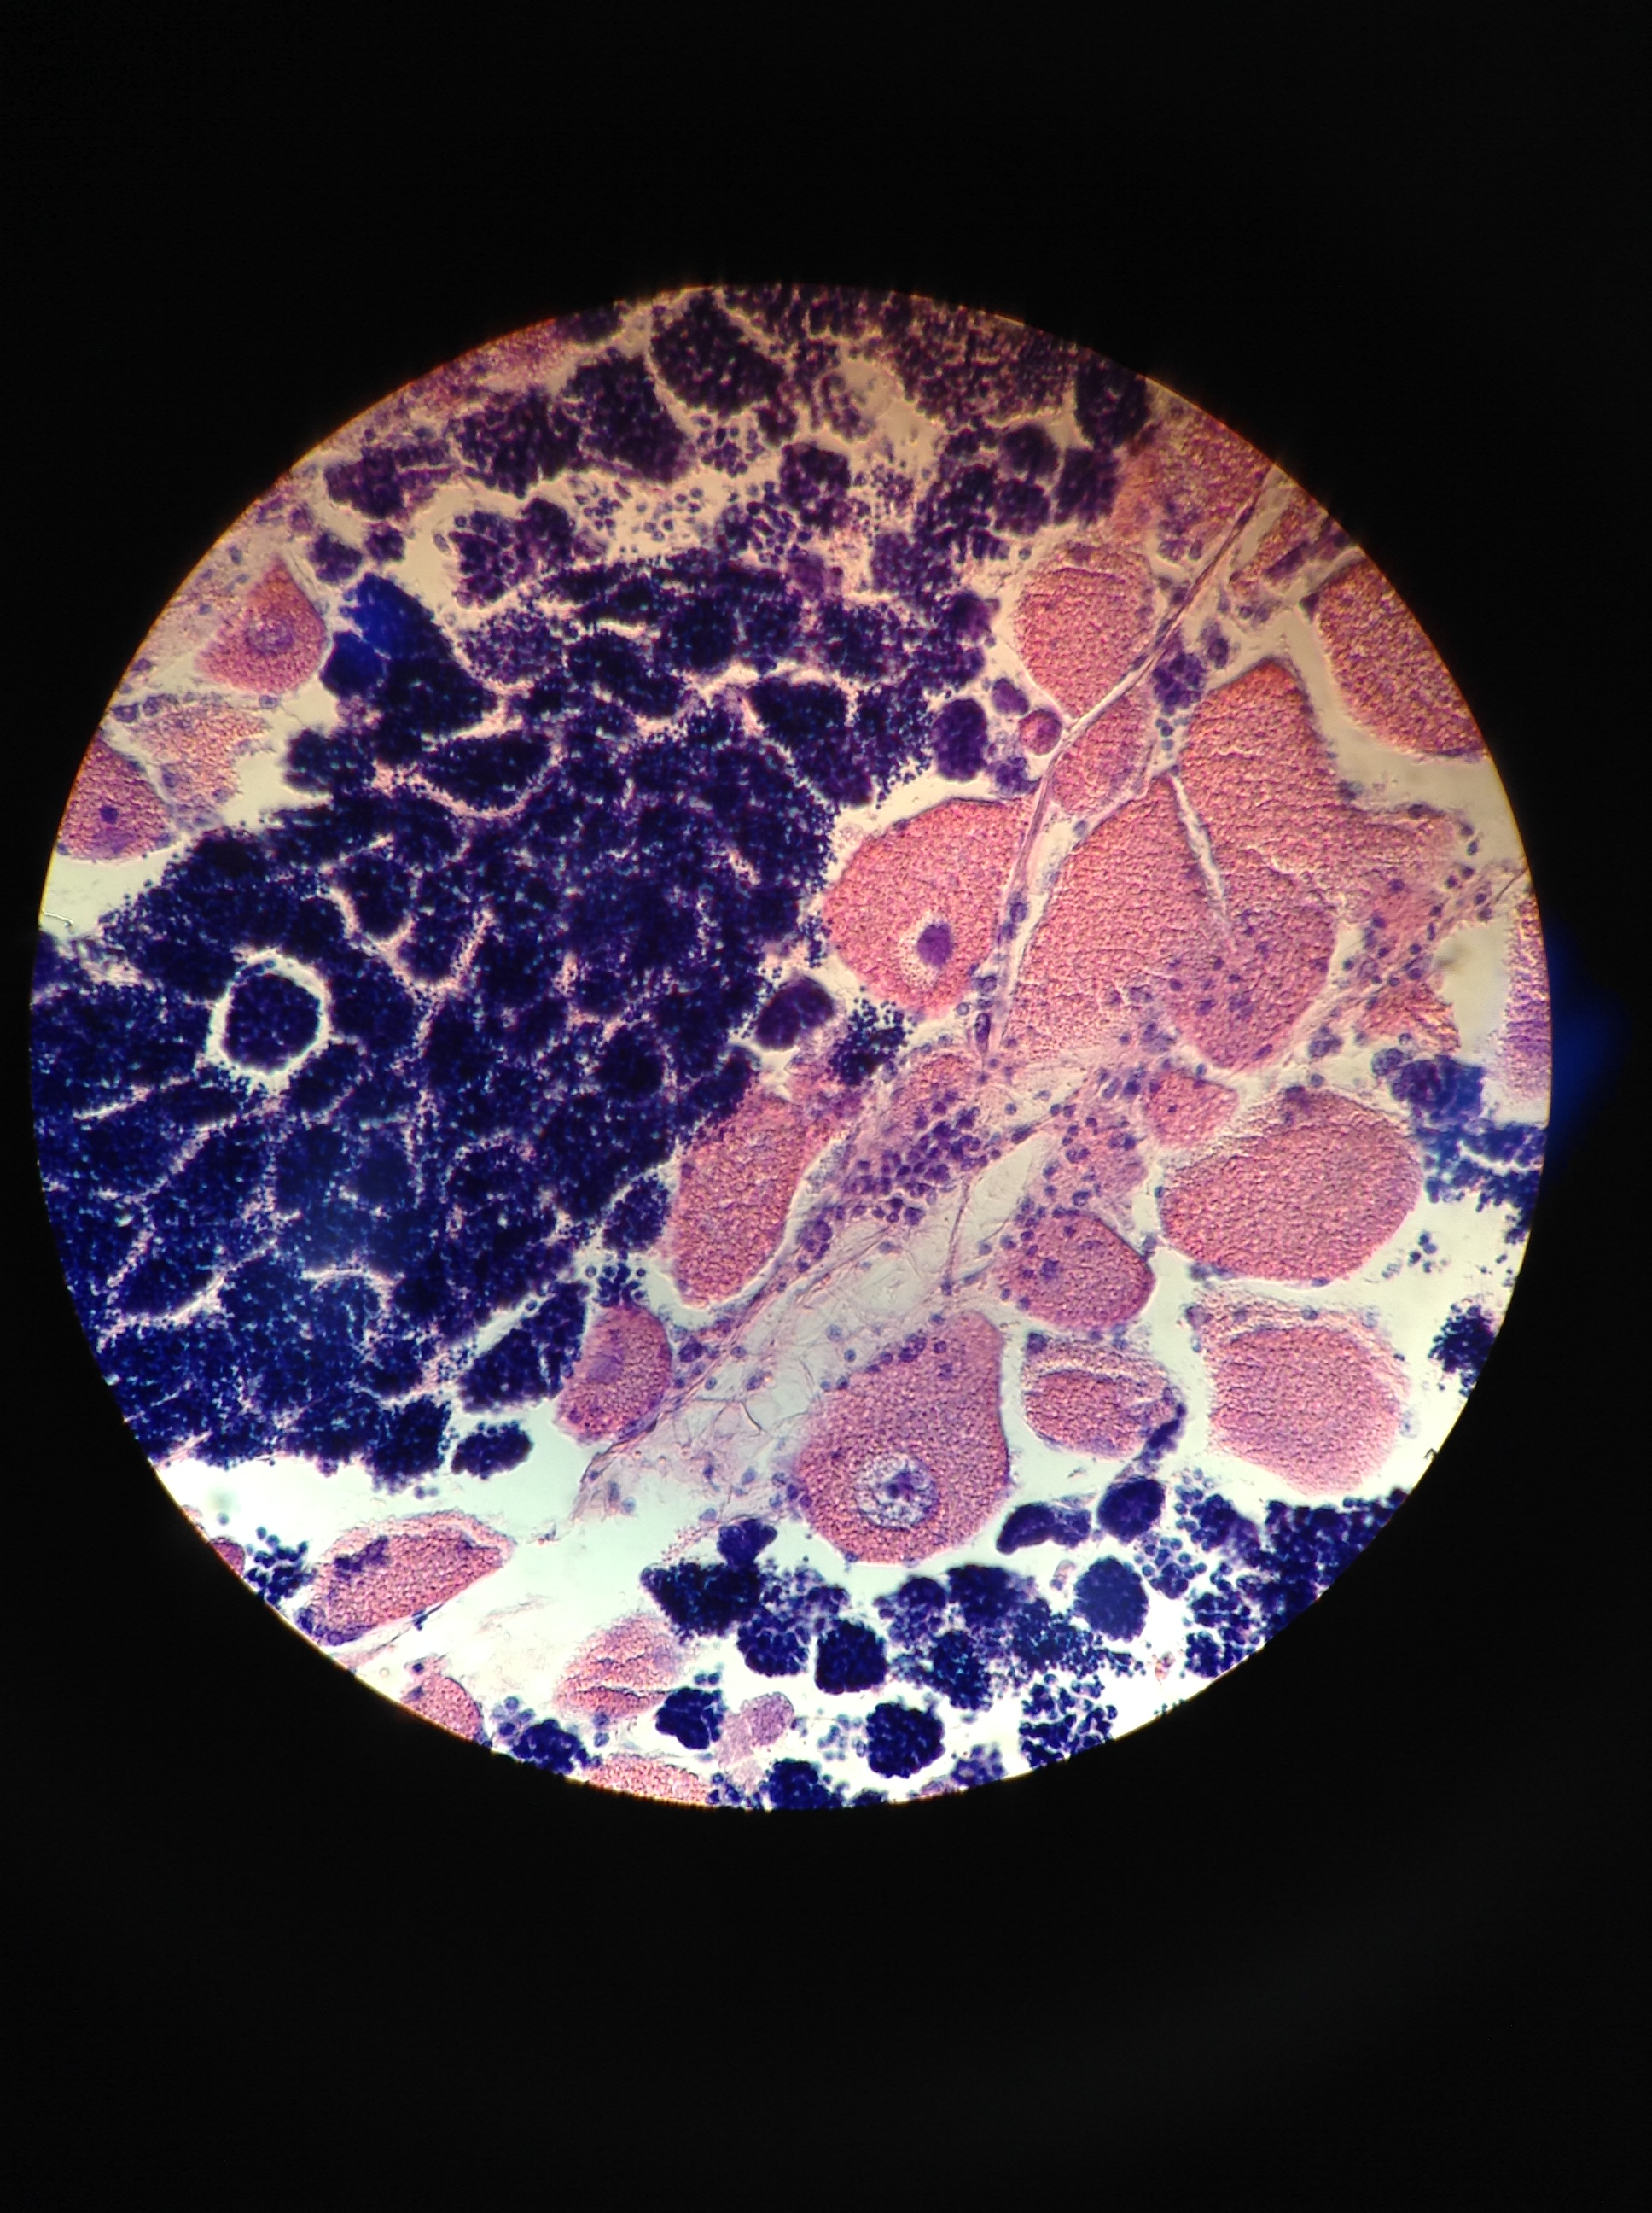
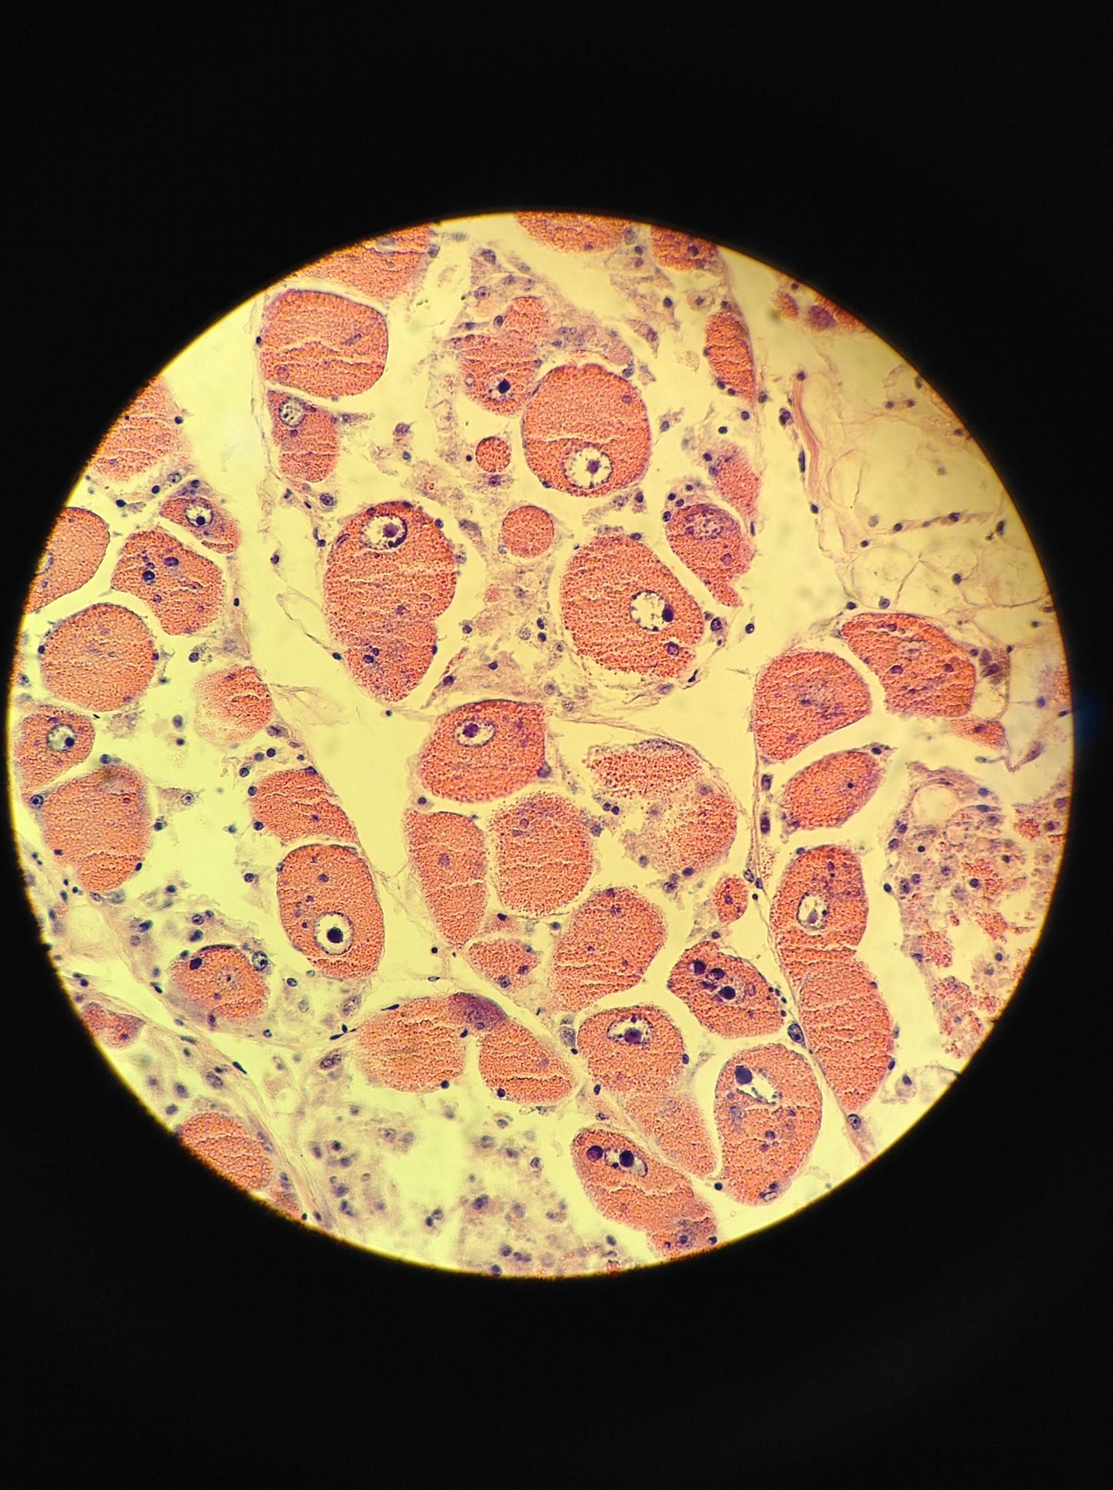
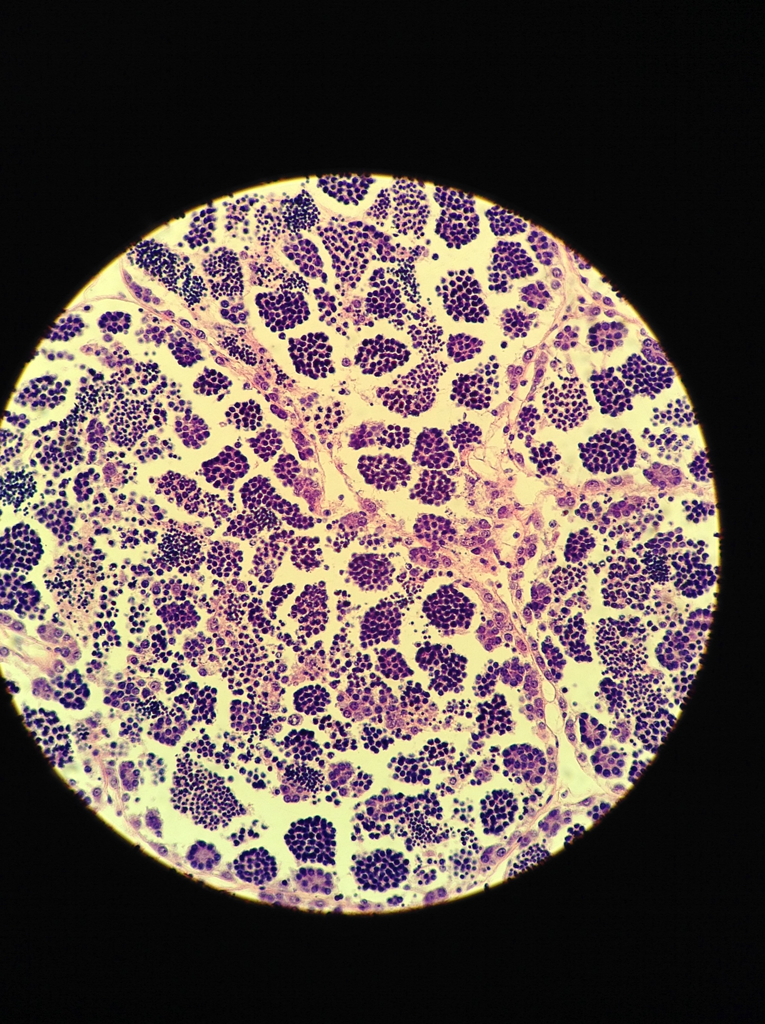
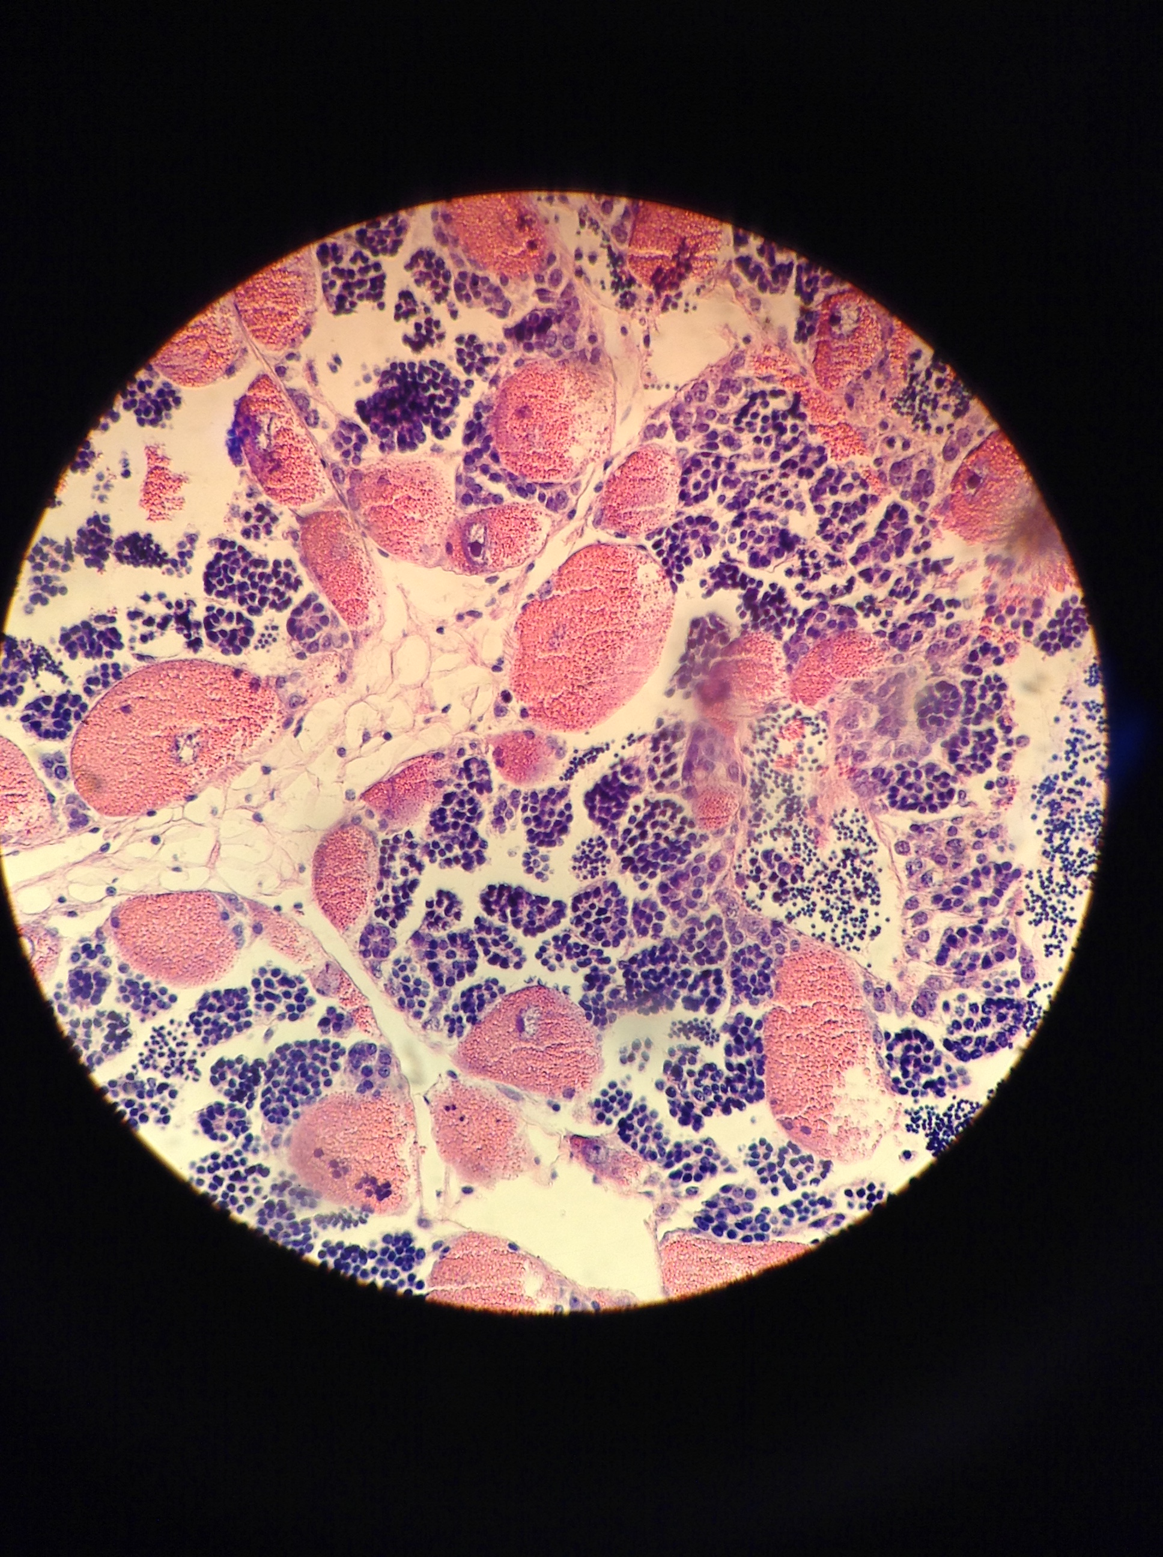
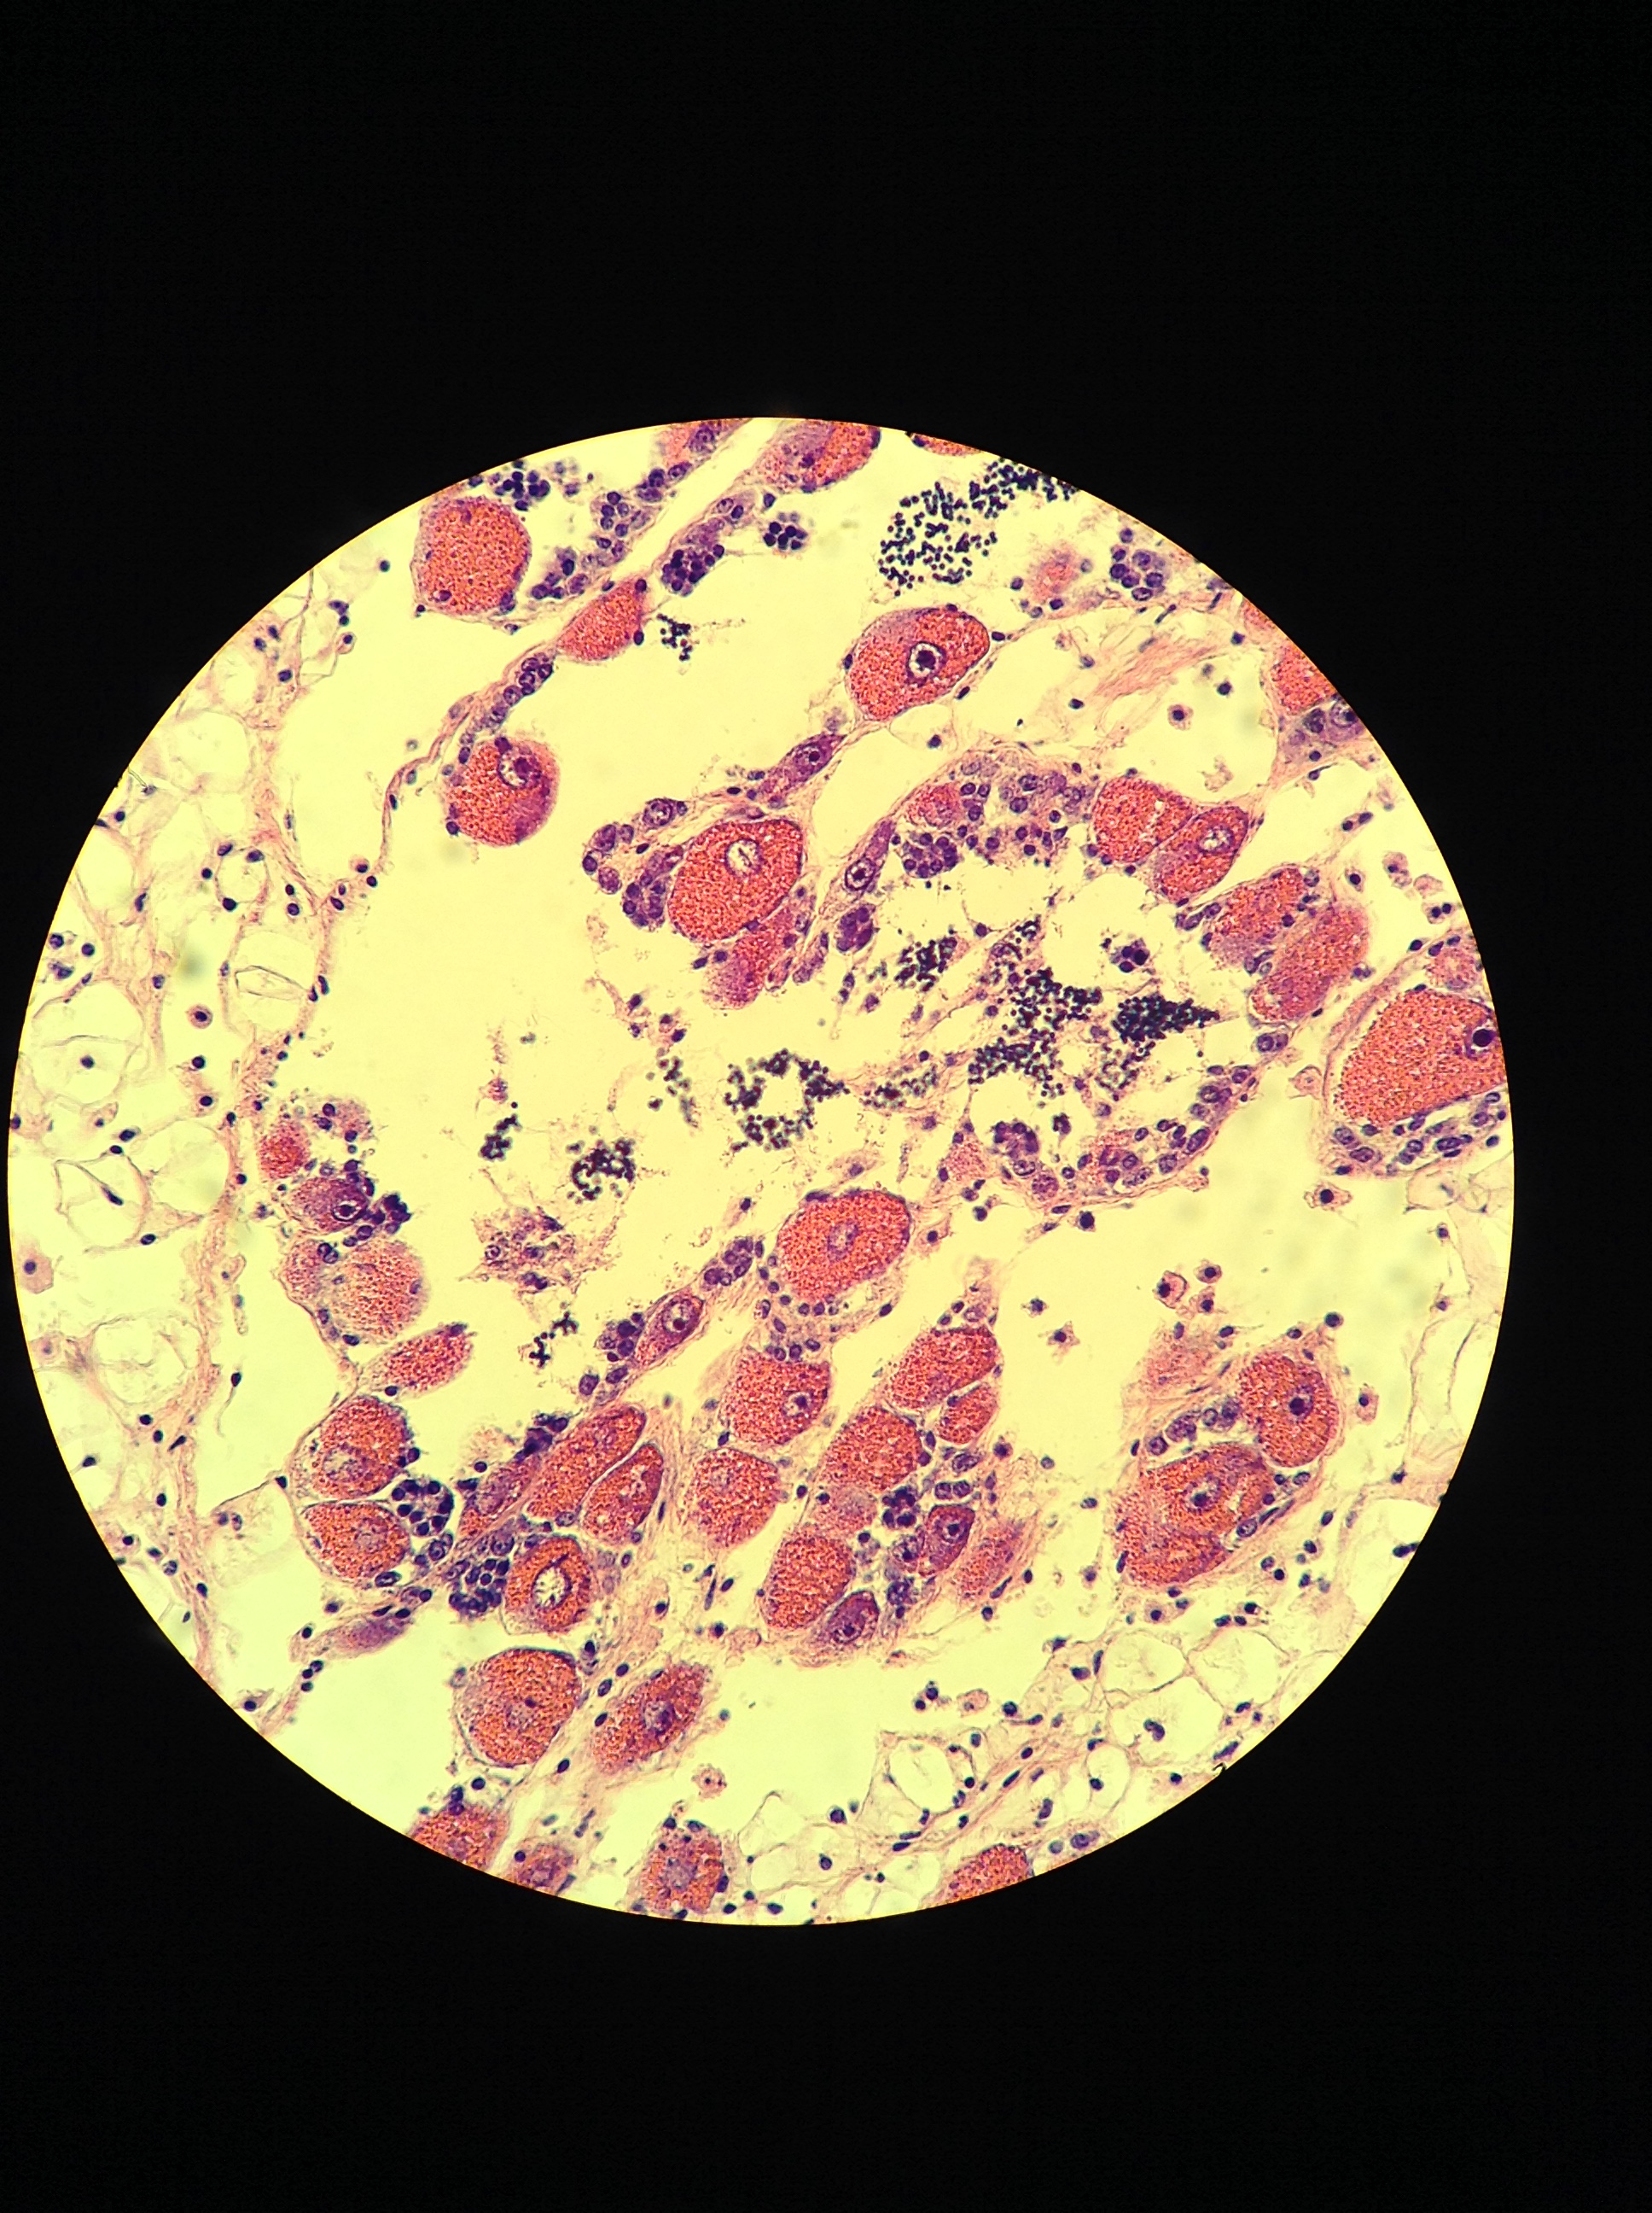
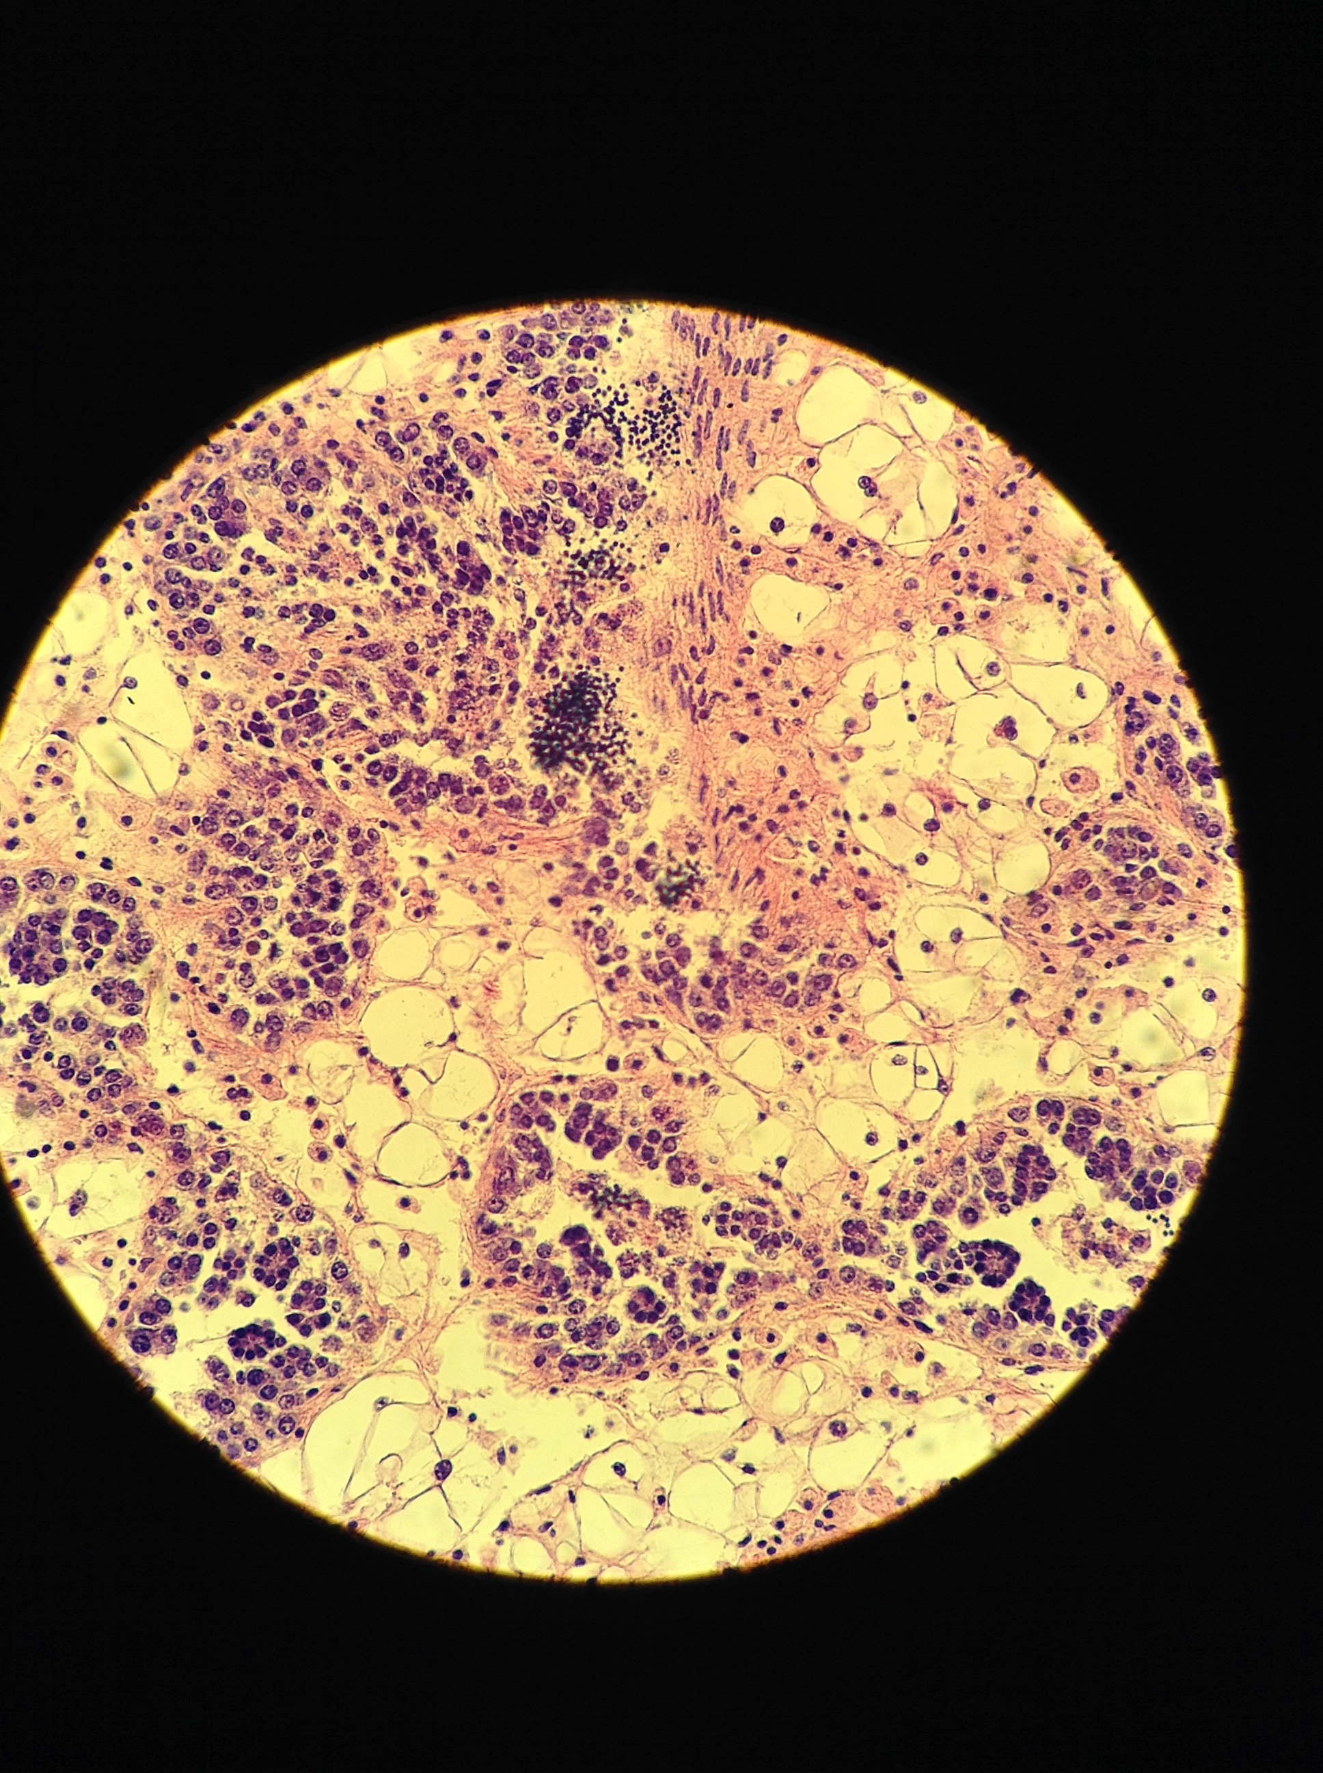
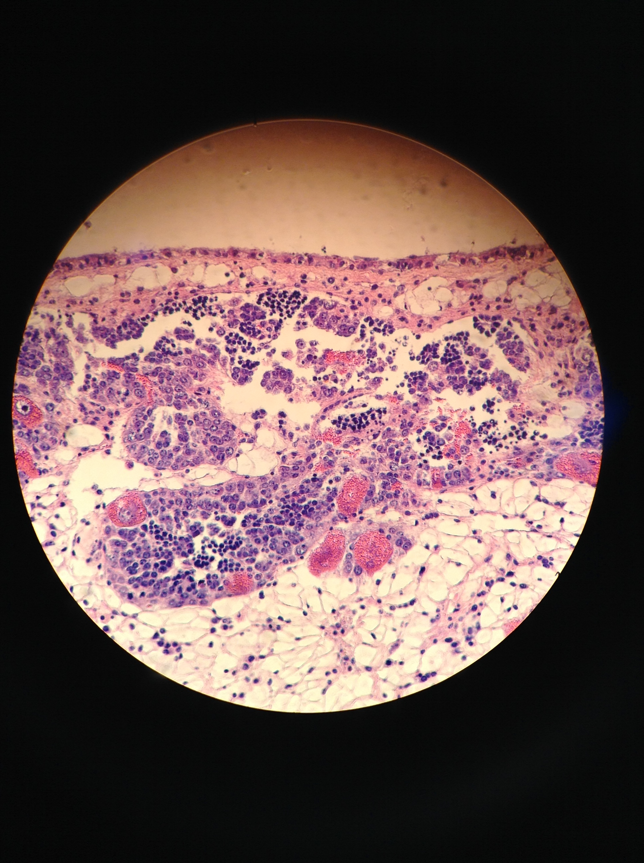
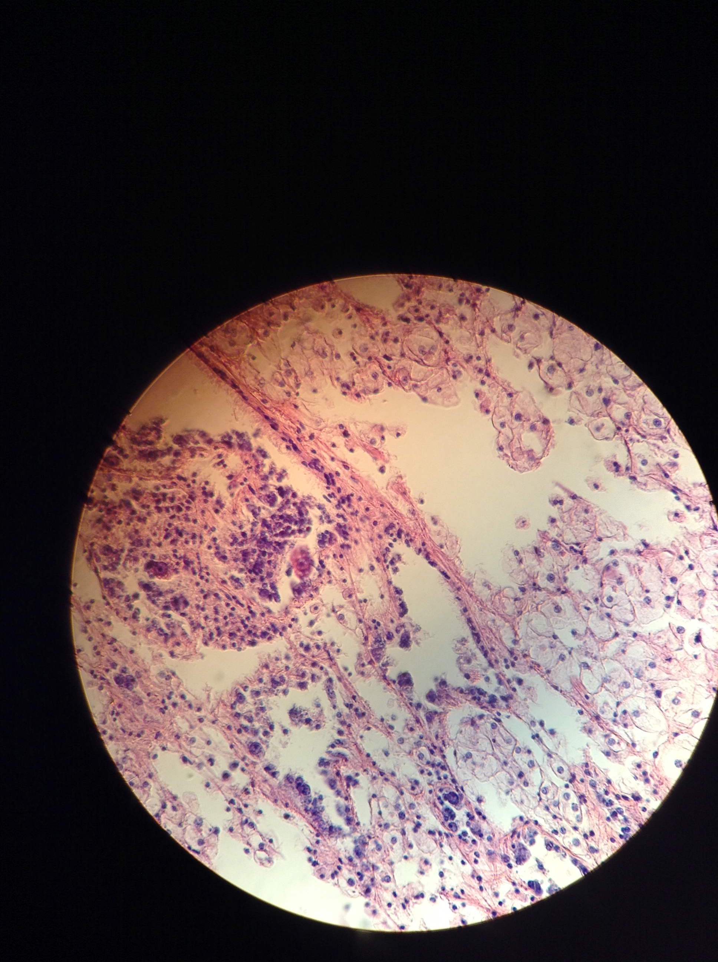
Olympia oyster gonad stage and sex
FEMALE
MALE
HERMAPH.
STAGE 4
SPAWNED/
RESORBING
None present
STAGE 3
RIPE
STAGE 2
ADVANCED
STAGE 1
EARLY
STAGE 0
NO ACTIVITY

Slide 20
Survival trended lower from low pH parents (not significant)
pH
p=0.067
Spawn & collect
Rear
Rear

Slide 21
Larval gene expression
COI: Cytochrome c oxidase, aerobic respiration
mt:ND5: NADH-ubiquinone oxidoreductase, mitochondrial electron transport
USP47: Ubiquitin component, DNA repair
TBC1D2: protein transport, GTPase activity
Tuba3a: Tubulin, cytoskeleton
Rpl8: ribosomal protein, cytoplasmic translation

Slide 22
Gonad gene expression First look at differential expression
pH
Spawn & collect
Rear
Heat Shock Protein: stress response, protein chaperone / repair

Slide 23
Gonad gene expression First look at differential expression
pH
Spawn & collect
Rear
Cytochrome c oxidase: aerobic respiration

